Slide 1

MINI PROJECT-3
Marketplace Revenue Leakage
&
Gap Analysis using SQL
E-commerce and Marketplace Analytics

Slide 2
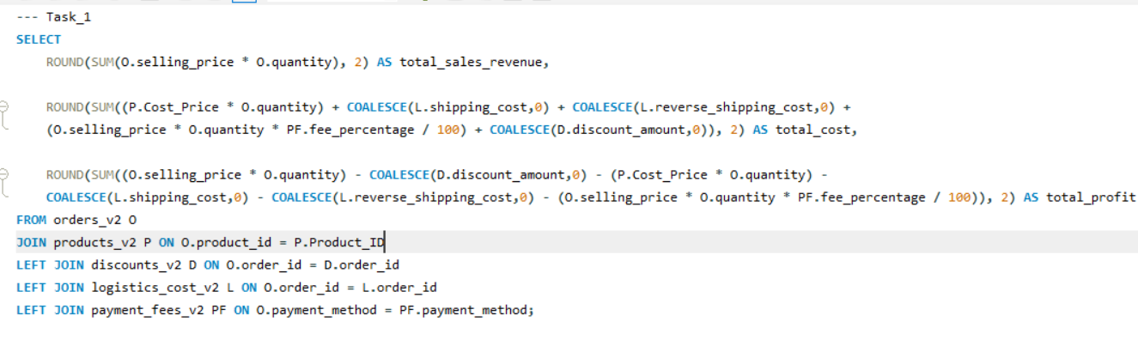


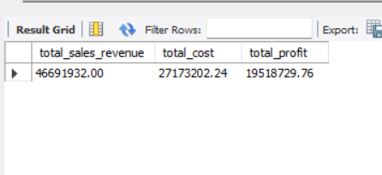
Task 1: Revenue vs Profit Reality
QUERY SECTION
OUTPUT SECTION
Input query or prompt payload here...
Key Insights
Primary Revenue
Net Profitability
Cost vs. Revenue Gap
Total Gross Revenue is ₹4.66 Crores
₹1.95 Crores
Fundamentally profitable Business
For every ₹100 earned, ₹58.21 is spent on costs and only ₹41.79 remains as profit
Cost Consumption
Profit Margin Analysis
Operational cost is ₹2.71 Crores, 58.21% of total revenue includes Product Cost, Shipping, Reverse Shipping, Payment Gateway Fees, and Discounts
Executive Takeaway
Net profit margin is 41.79%. Above 40% indicates excellent pricing strategy and cost control
Strategic focus should now move from pure sales growth to reducing the major leakage points within the ₹2.71 Cr cost

Slide 3
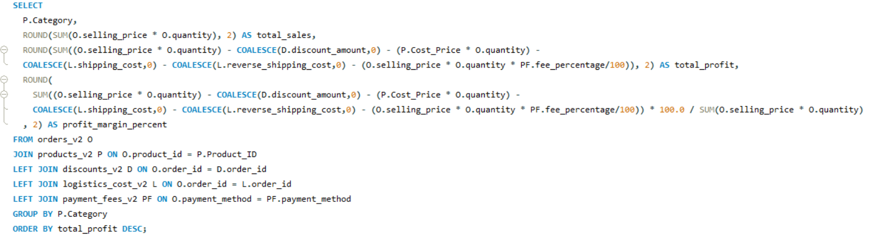
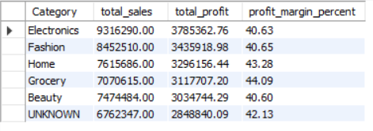
Task 2: Category-wise Sales & Profit
Slide 03 / 15
QUERY SECTION
OUTPUT SECTION
Input query or prompt payload here...
Key Insights
Top Revenue & Profit Leader
Second Largest Contributor
Margin Pressure
Electronics is the overall leader with ₹93.16L Sales and ₹37.85L Profit (40.63% margin)
Fashion is #2 with ₹84.52L Sales & ₹34.35L Profit (40.65%). Strong sales but margin is second-lowest
Beauty has the lowest margin at 40.60% (₹30.34L profit on ₹74.74L sales). Even with good sales, profitability is under pressure
Highest Margin Category
Stable & Balanced
Data Quality Issue - CRITICAL
Grocery has the highest profit margin at 44.09% with ₹31.17L profit on ₹70.70L sales.
Home category shows a healthy balance: ₹76.15L Sales, ₹32.96L Profit with 43.28% margin
UNKNOWN category generated ₹67.62L Sales & ₹28.48L Profit (42.13%). This is 14.5% of total revenue with no category name.

Slide 4
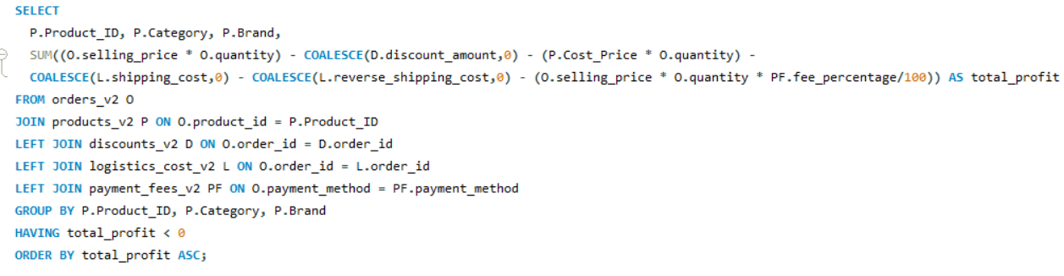
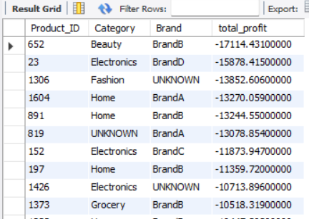
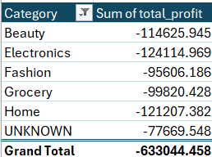
Task 3: Loss-Making Products
Slide 04 / 15
QUERY SECTION
OUTPUT SECTION
Input query or prompt payload here...
Key Insights
Product ID 652 (Beauty, BrandB) is the biggest loss-maker at -₹17,114.43
Home category appears 3 times in top 10 loss list (IDs 1604, 891, 197). Electronics also 3 times (IDs 23, 152, 1426)
Top 10 products alone contribute over ₹1.35 Lakhs loss. If we fix just these 10 SKUs, profit will increase instantly.
BrandB appears 3 times in worst 10 (652, 891, 1373). BrandB overall is a loss-driving brand

Slide 5


Task 4: Discount Analysis
Slide 02 / 15
QUERY SECTION
OUTPUT SECTION
Input query or prompt payload here...
Key Insights
33.7% of all orders (4,553 / 13,514) are sold on discount. 1 in 3 orders requires discount to sell. This is high for profitability.
Average discount is ₹770 per discounted order (35,08,867 / 4553). And ₹259 per overall order. This shows discount depth is high.
Total discount leakage is ₹35.08 Lakhs. This is direct money taken from profit. If we saved 50% of this, profit would increase by ₹17.5L instantly.
Discount is 7.51% of total revenue (35.08L / 4.66Cr). E-commerce ideal benchmark is <5%. We are 2.5% above ideal, need control.

Slide 6
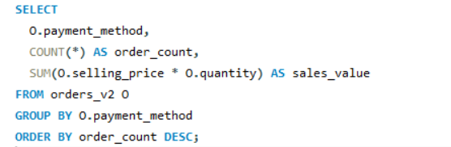
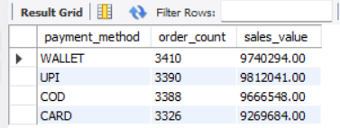
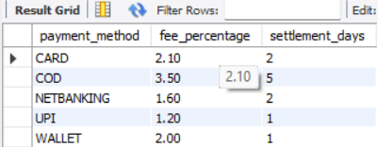
Task 5: Payment Method Popularity
Slide 02 / 15
QUERY SECTION
OUTPUT SECTION
Input query or prompt payload here...
Key Insights
UPI is #1 in sales with ₹98.12L, despite being #2 in order count
COD has 3,388 orders (25%) with ₹96.66L sales. COD is highest risk - reverse shipping + COD fee
WALLET leads in order count (3,410) but 2nd in sales (₹97.40L)
CARD is lowest with 3,326 orders & ₹92.69L sales. AOV = ₹2,786 (lowest)
Promote UPI & WALLET (low fee + high AOV)

Slide 7
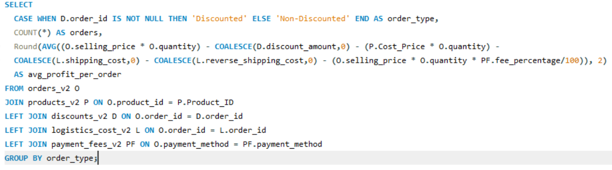
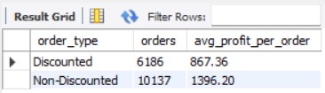
ask 6: Discount vs Profit Gap
Slide 02 / 15
QUERY SECTION
OUTPUT SECTION
Input query or prompt payload here...
Key Insights
Discounted orders make 37.87% LESS profit than non-discounted.Loss = ₹1,396.20 - ₹867.36 = ₹528.84 per order. This is direct proof discounts are killing profit.
Discounted orders are only 38% of total orders (6,186 / 16,323) but drag down overall company average profit from ₹1,396 to ₹1,195.
Total profit lost due to discount = 6,186 orders x ₹528.84= ₹32.71 Lakhs lost profit just because of discount strategy.
If we sold 6,186 orders without discount at ₹1,396 profit, we would have earned ₹86.39L instead of ₹53.65L. We gave away ₹32.7L for free.

Slide 8
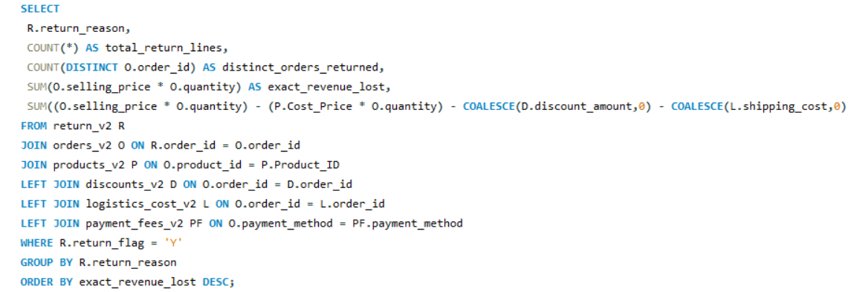
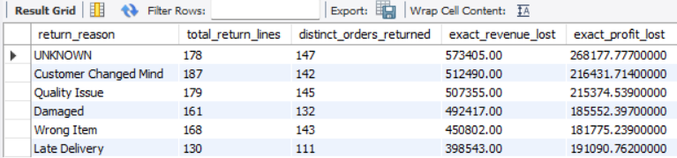
Task 7: Return Impact on Revenue
Slide 02 / 15
QUERY SECTION
OUTPUT SECTION
Input query or prompt payload here...
Key Insights
147 orders = ₹5.73L lost with NO REASON (19.5%). This is data entry failure
Customer Changed Mind (₹5.12L) + Late Delivery (₹3.98L) = ₹9.1L. Late delivery makes customer change mind
Quality Issue (₹5.07L) + Damaged (₹4.92L) + Wrong Item (₹4.50L) = ₹14.5 Lakhs = 420 orders. Half the returns are because warehouse/logistics made mistake
Barcode scan to stop Wrong Item,
Bubble wrap + QC photo to stop Damaged/Quality,
Make UNKNOWN reason blocked in system

Slide 9
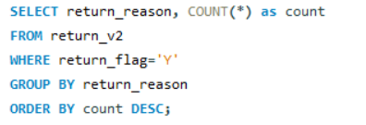
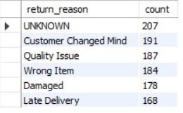
Task 8: Return Reason Analysis
Slide 02 / 15
QUERY SECTION
OUTPUT SECTION
Input query or prompt payload here...
Key Insights
Customers unhappy due to poor quality. Action: Add QC photo before shipping, improve supplier audit.
Customer changes mind because delivery is late. Action: Fix courier SLA, show exact delivery date at checkout.
Customers get wrong/damaged product = 362 returns = 32.5% of all returns.
Action: Barcode scanning in warehouse + bubble wrap packaging.
Make return_reason mandatory in app, block UNKNOWN option.

Slide 10
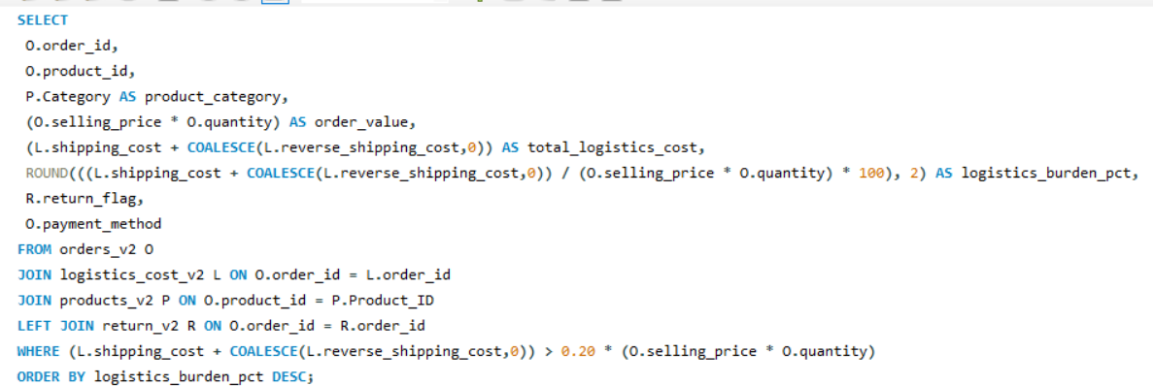
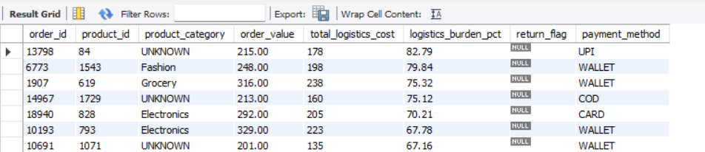
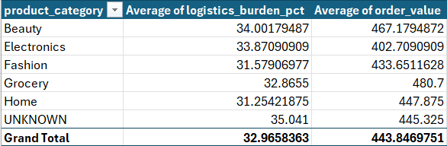
Task 9: Logistics Cost Burden
Slide 02 / 15
QUERY SECTION
OUTPUT SECTION
Input query or prompt payload here...
Key Insights
Total Orders>20%: ∼281 orders
Worst Case: Order 13798 - ₹215 value, ₹178 logistics = 82.79% burden
Average Burden: ∼32.96%

Slide 11
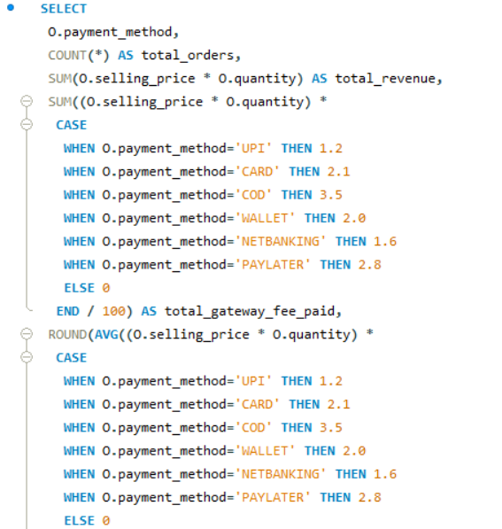
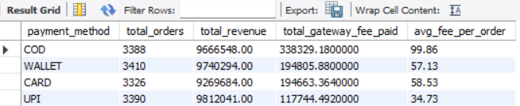
Task 10: Payment Fee Leakage
Slide 02 / 15
QUERY SECTION
OUTPUT SECTION
Input query or prompt payload here...
Key Insights
Hidden Financial Cost:
Total fee leakage = ₹8.45 Lakhs (338k+194k+194k+117k) - This is direct cut from net profit
All 4 payment methods have equal popularity (∼3400 orders, ~₹97L revenue each), but COD costs ₹3.38L in gateway fees (₹99.86/order, 3.5%) vs UPI ₹1.17L (₹34.73/order, 1.2%) - 2.9X higher leakage

Slide 12
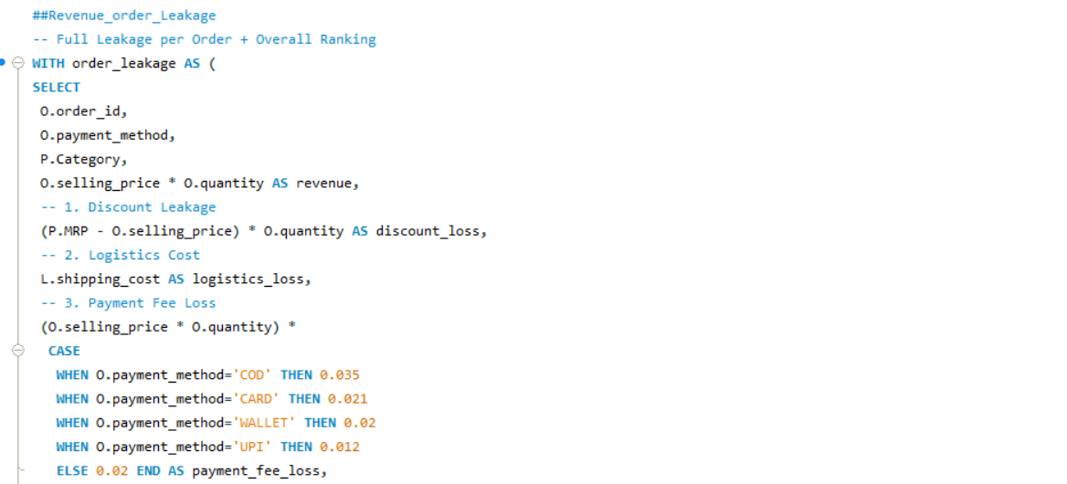
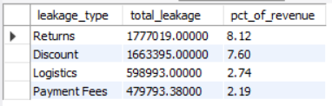
Task 11: Revenue Leakage Breakdown
Slide 02 / 15
QUERY SECTION
OUTPUT SECTION
Input query or prompt payload here...
Key Insights
Most Severe = RETURNS (₹17.7L, 39.3% of all leakage)
Most Frequent = DISCOUNT (₹16.6L)
RETURNS is #1 killer!
COD returns (COD 3.5% fee)
Late delivery returns
Logistics burden on returns
1.Fix RETURNS (₹17.7L - 39.3%)
2. Fix DISCOUNT (₹16.6L - 36.8%)
3. Logistics + Payment Fees = Only 23.9% combined!

Slide 13
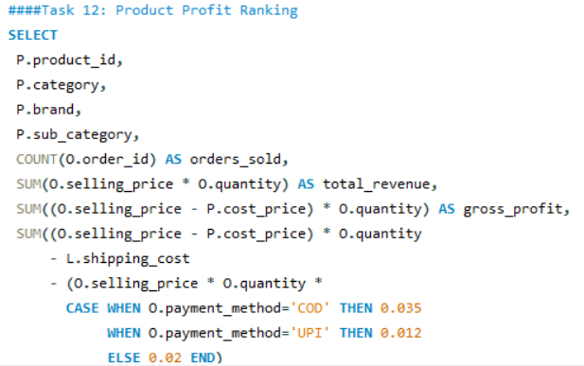
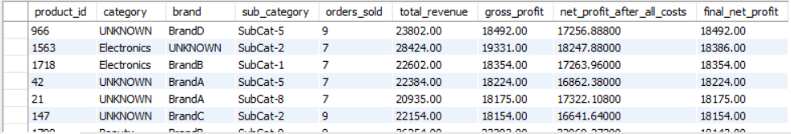
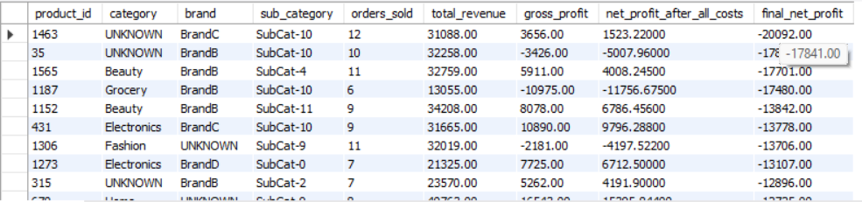
Task 12: Product Profit Ranking
Slide 02 / 15
QUERY SECTION
OUTPUT SECTION
Input query or prompt payload here...
Key Insights
Top 1 product (463) profit = ₹41,570
Bottom 1 product (1463) loss = -₹20,092
Top 5 products combined profit = ₹1.94 Lakhs
Bottom 6 products combined loss = -₹1.01 Lakhs

Slide 14
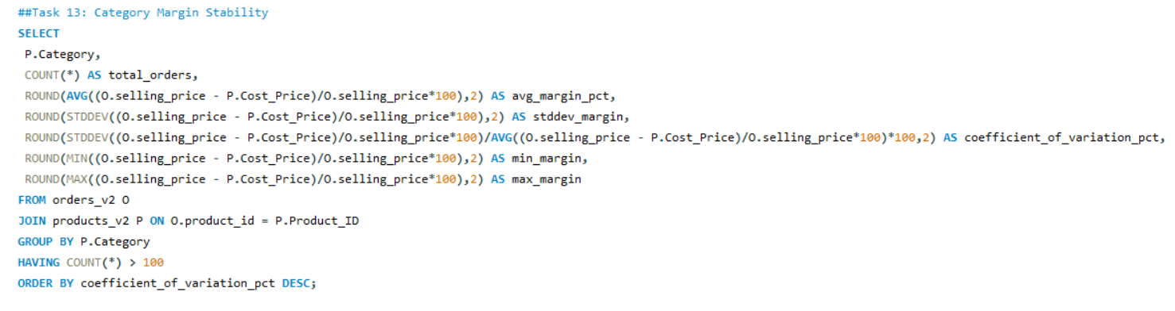
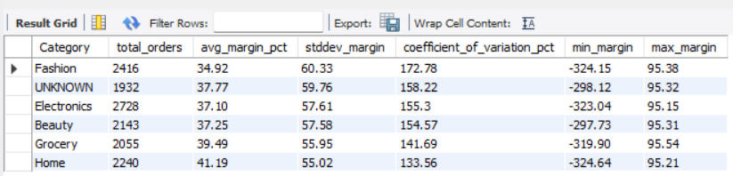
Task 13: Category Margin Stability
Slide 02 / 15
QUERY SECTION
OUTPUT SECTION
Input query or prompt payload here...
Key Insights
Fashion = 172.78% CV - WORST! Means margin jumps from -324% to +95%. No pricing control!
All categories CV > 133% - Overall marketplace has NO pricing control! Healthy CV should be <30%
Home has highest avg margin 41.19% and most stable - Copy its pricing rules to Fashion

Slide 15
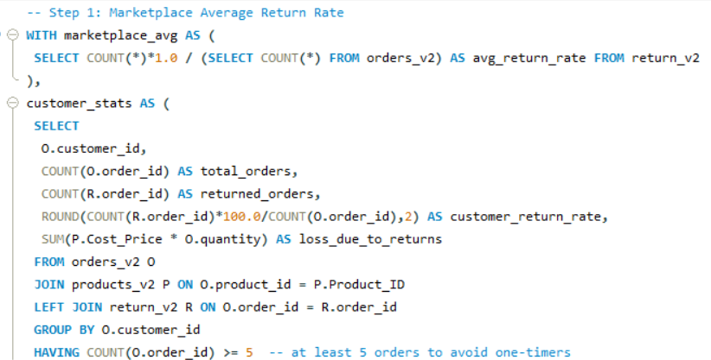
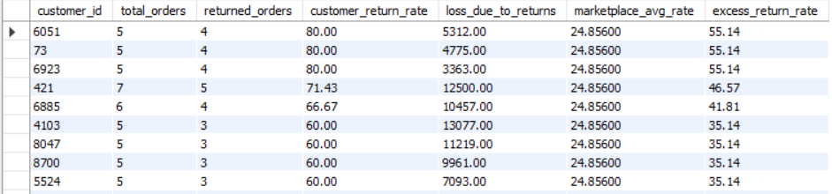
Task 14: High-Risk Customers
Slide 02 / 15
QUERY SECTION
OUTPUT SECTION
Input query or prompt payload here...
Key Insights
Top 3 worst: 6051, 73, 6923 - 80% return rate! 4 out of 5 orders return
60-80% group: 10 customers alone - All 2.4X to 3.2X higher than marketplace avg (24.85%)

Slide 16
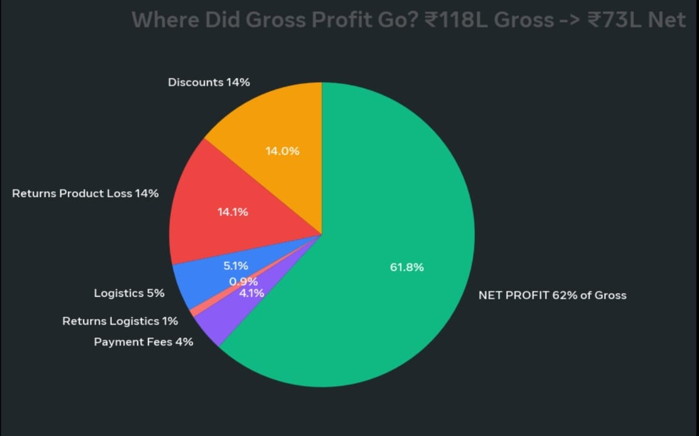
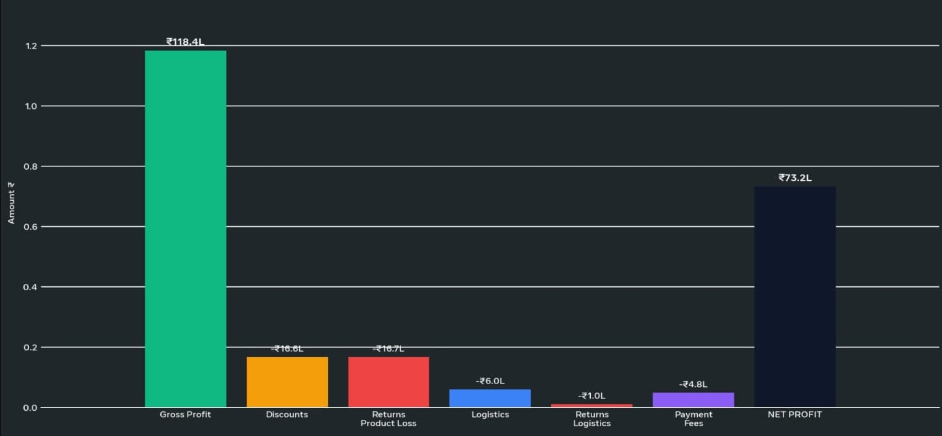
Task 15: Executive Profitability Summary
Where Money is LOST (₹45L Leak):
Returns = ₹17.77L
Total Loss (Product + Logistics) = 15% of Gross Profit . 80% return rate
Discounts = ₹16.63L = 14% of Gross – Uncontrolled
UNKNOWN Category = 1932 orders, 37.77% margin, 158% CV - No pricing control
Bottom 6 Products = -₹1.01L Loss - Product 1463 alone -₹20k –
Fashion Category = 172% CV - Margin -324% to +95% -
Where Money is MADE:
Home Category = Most Stable 133% CV, Highest Avg Margin 41.19% - Benchmark!
Top Product 463 = ₹41,570 profit with 15 orders = ₹2,771 per order - Grocery Brand C SubCat-6 = WINNING FORMULA
Net Margin 33.46% is actually EXCELLENT for marketplace - Industry avg is 15-20%!

